Slide 1
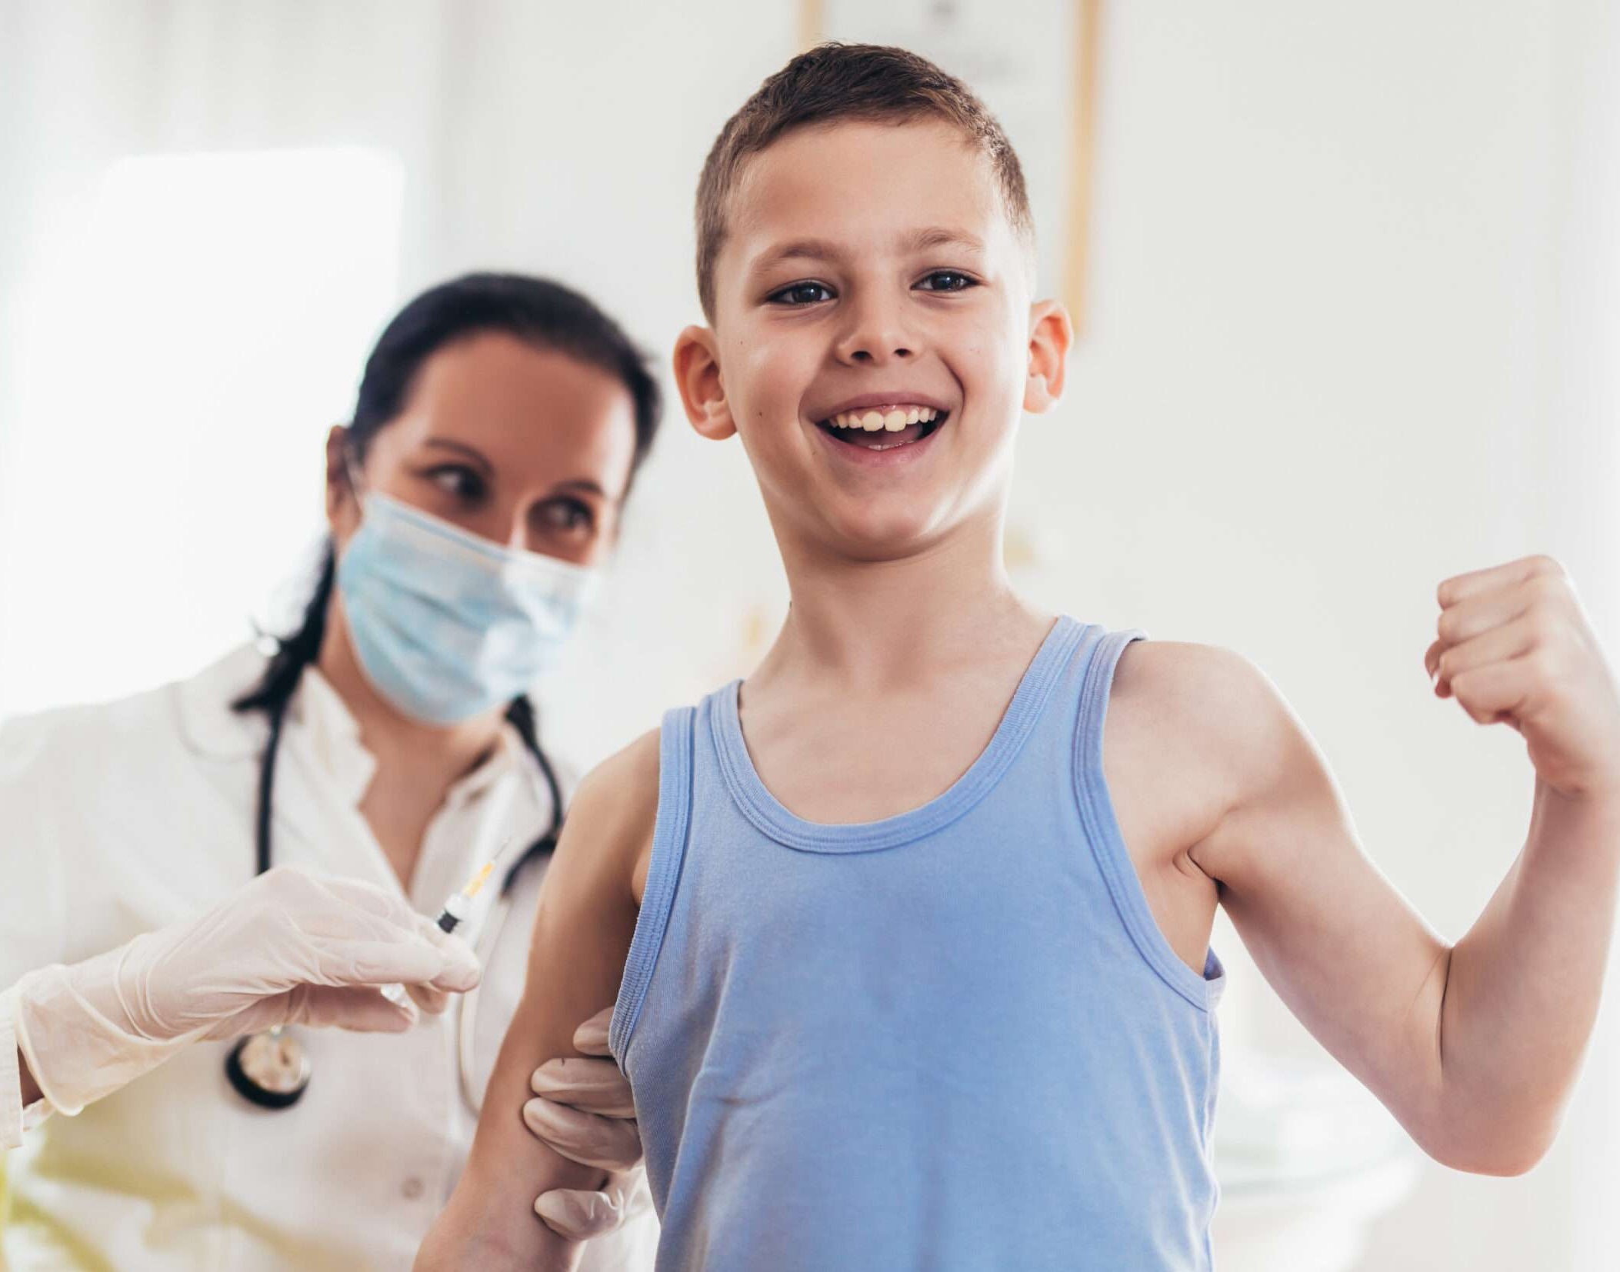

Having a
Vaccination
Developed by KU Children’s Services Sector Capacity Building Program with funding from the NSW Department of Education

Slide 2
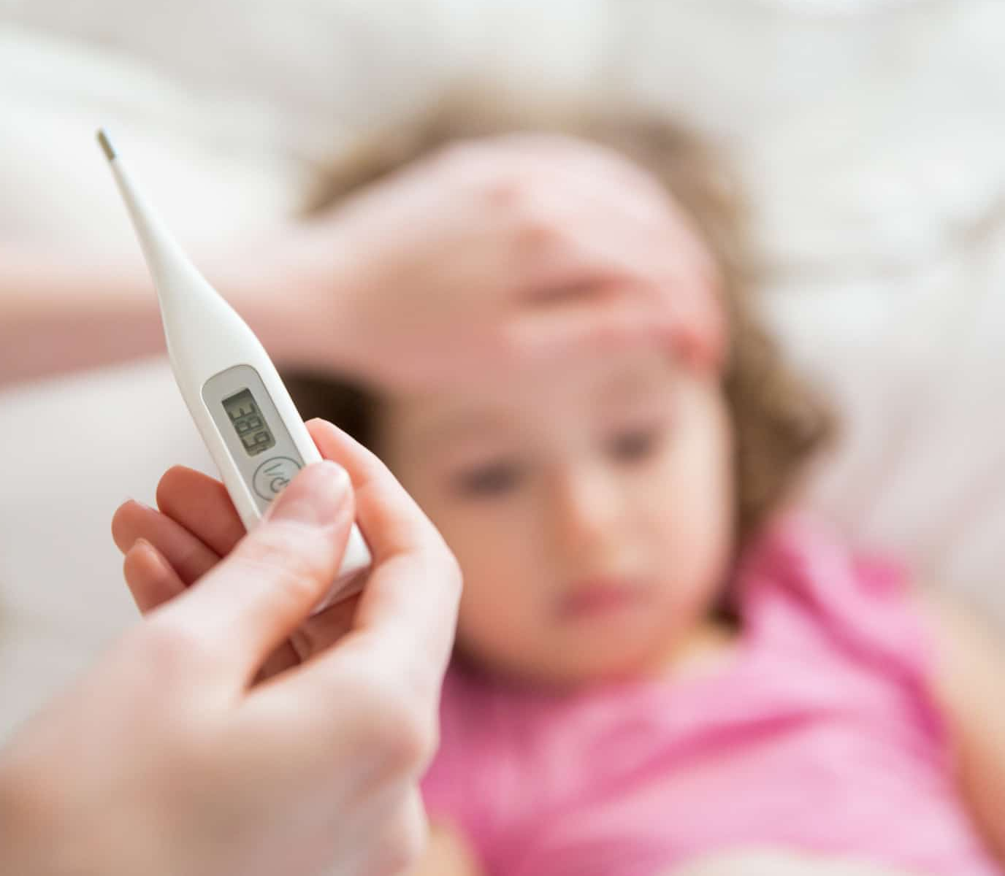
Diseases are caused by tiny germs that we can’t see and can make us very sick.

Slide 3
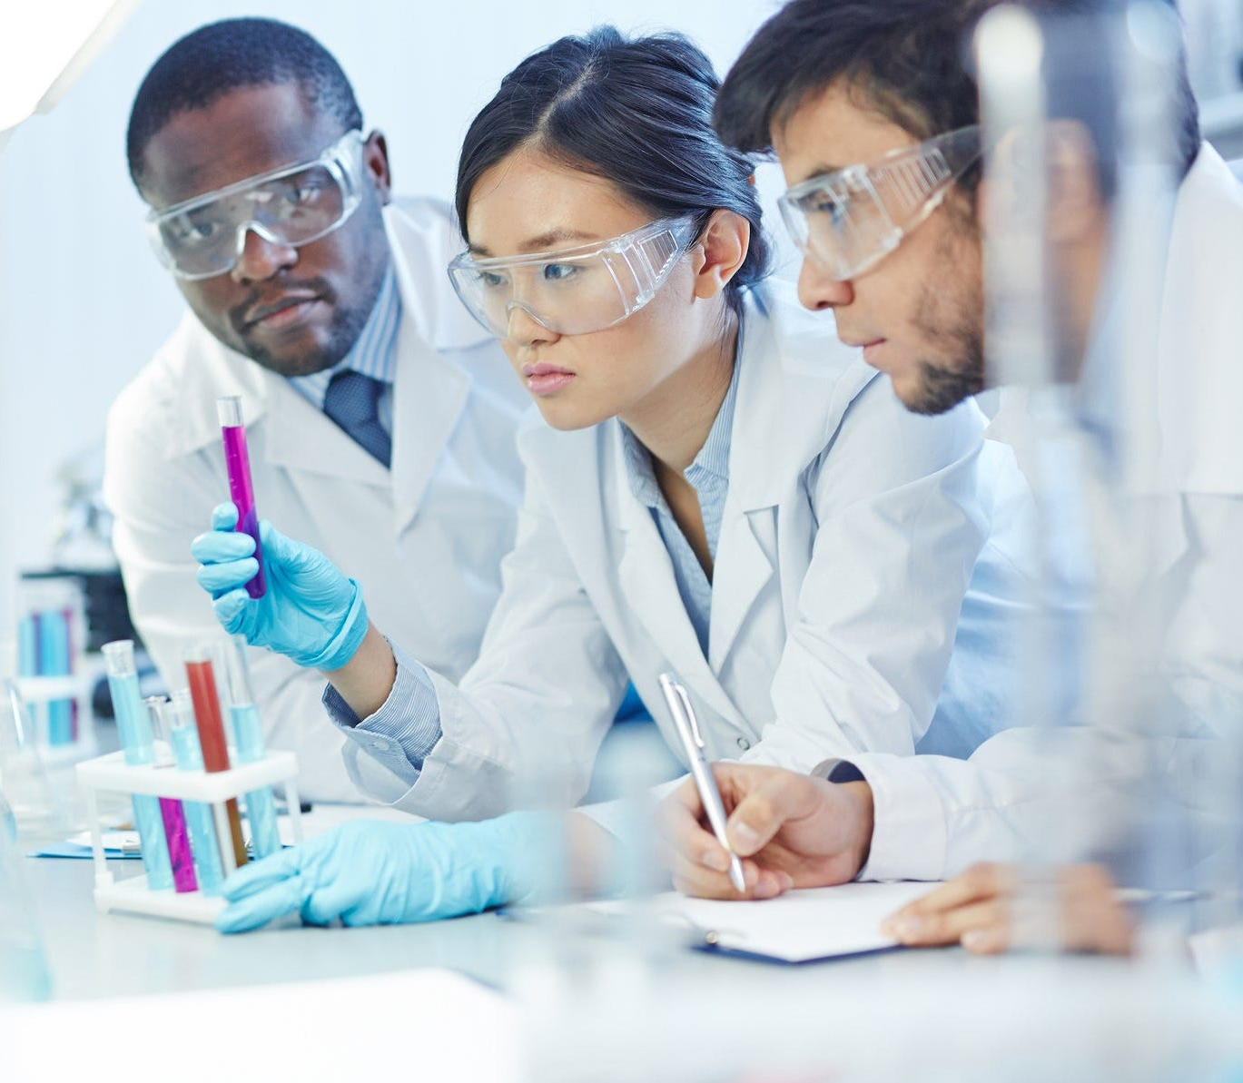
Scientists have made medicines to help our bodies fight these germs.
These medicines are called vaccinations or immunisations.

Slide 4
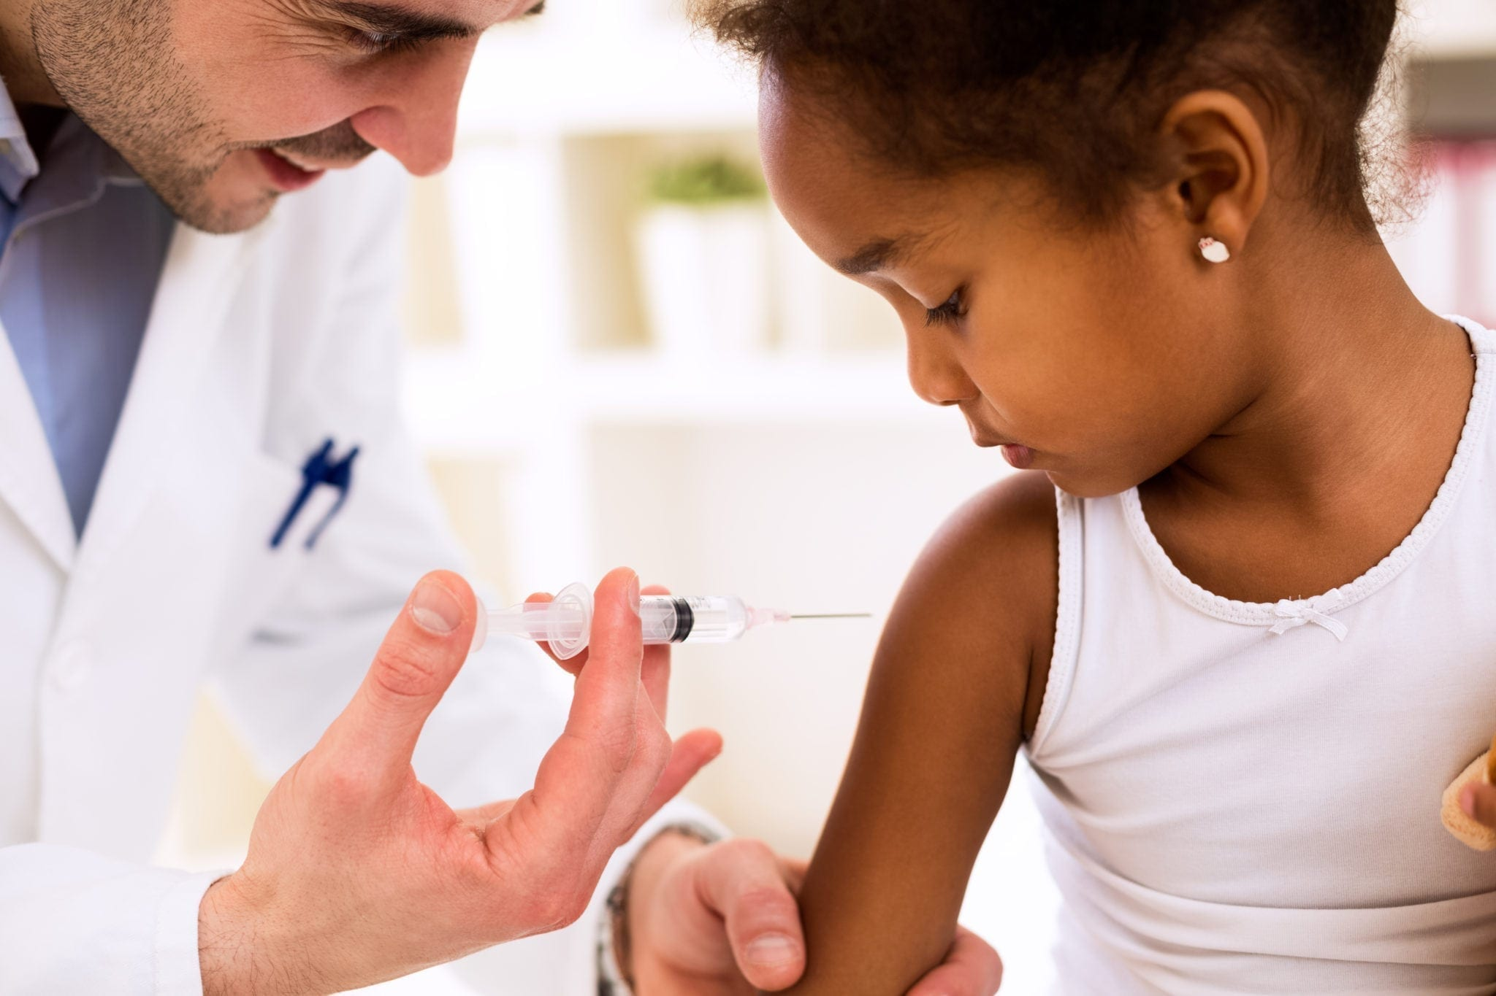
A doctor or nurse can give me a vaccination using a needle.

Slide 5
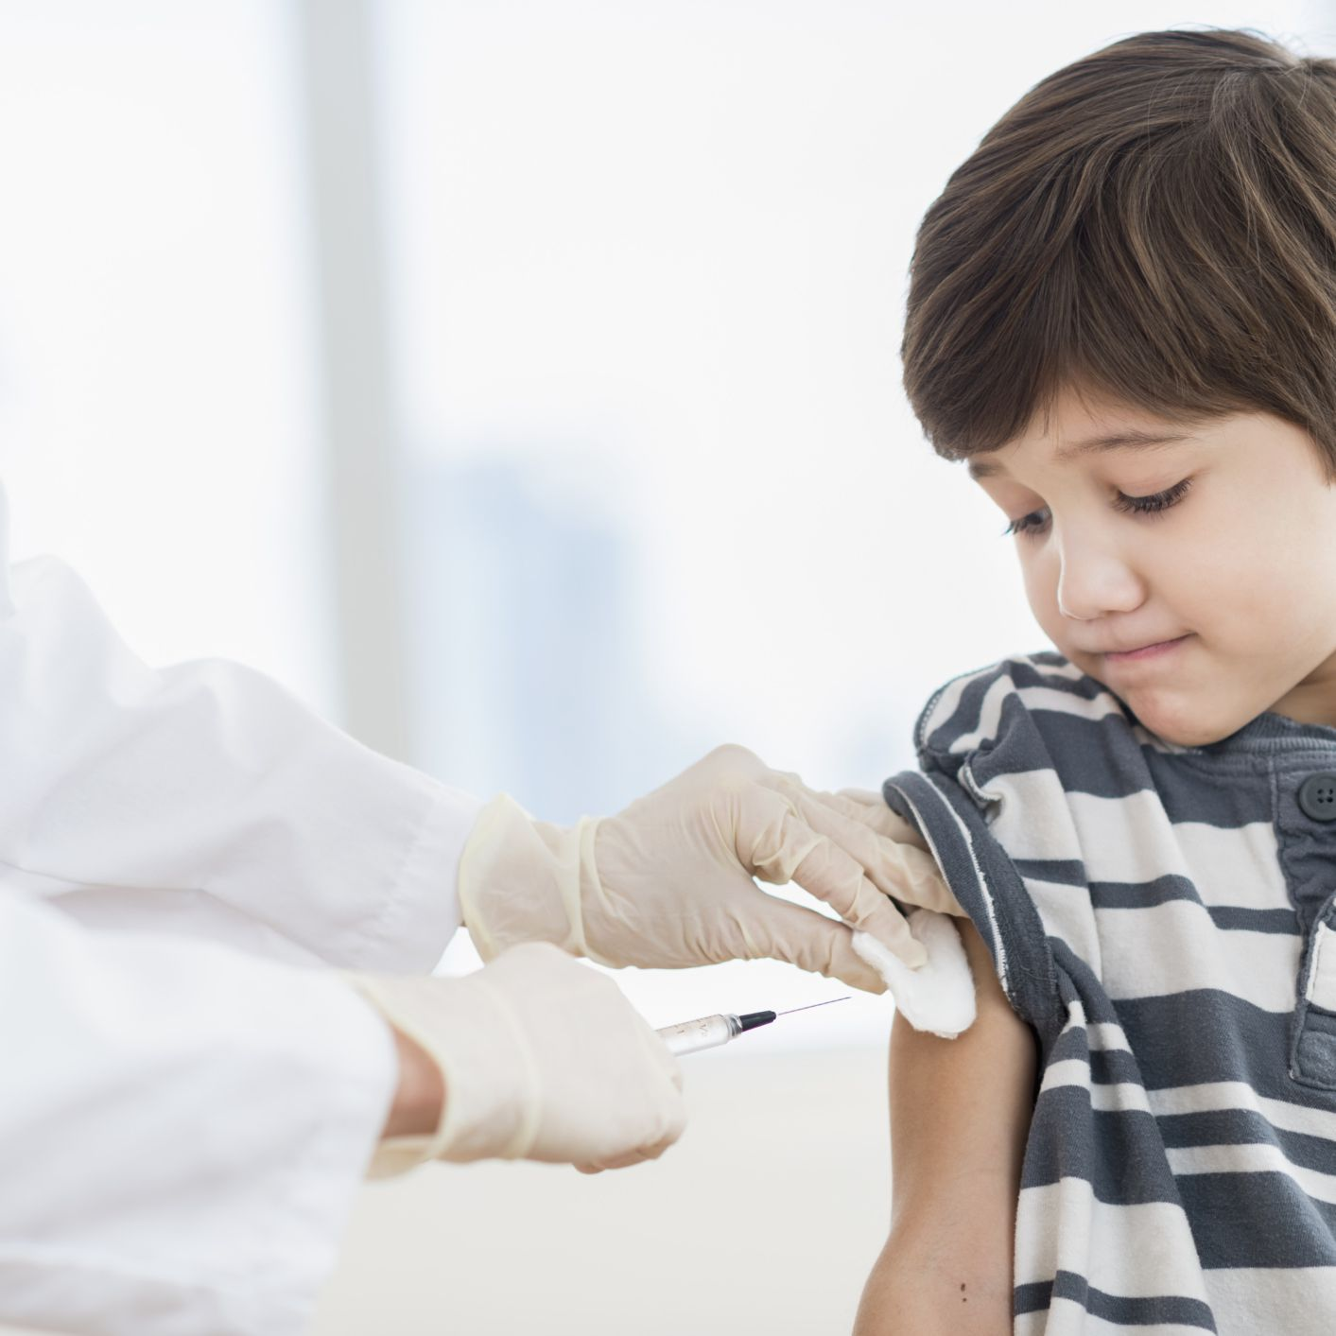
I can try to sit very still while I’m getting my vaccination.
It might hurt a bit, but only for a moment.

Slide 6
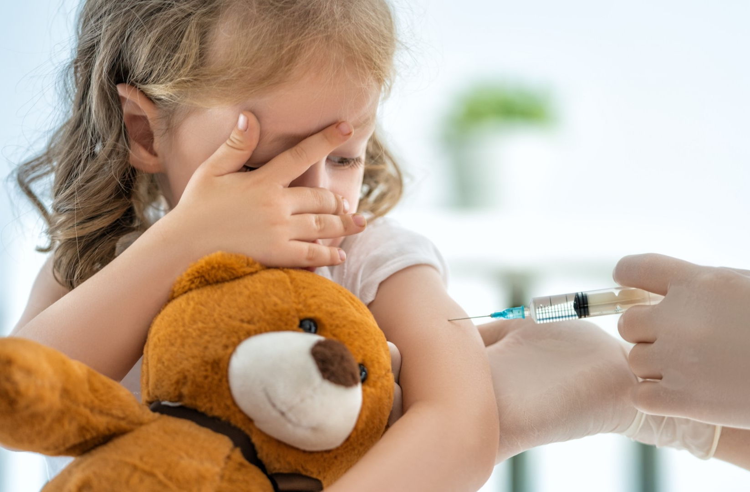
When I am getting my vaccine, Mum or Dad will be with me and I can try closing my eyes or hugging my favourite toy.
(insert comfort item/routine relevant to individual child)

Slide 7
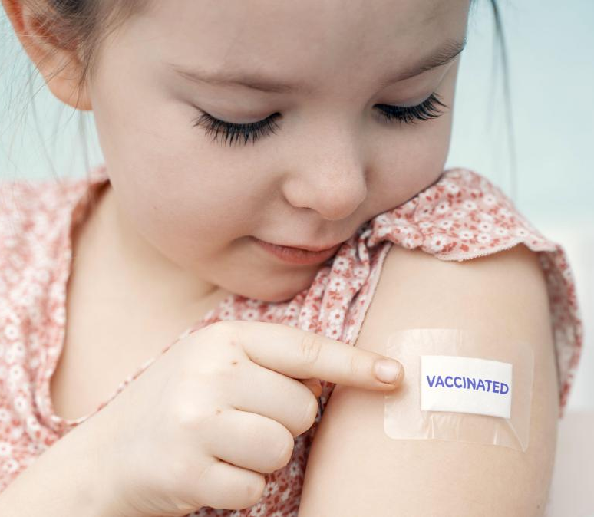
The doctor or nurse might put a bandaid on the spot where I had my vaccination.

Slide 8

My body will use the medicine to become super strong at fighting those diseases.

